Slide 1
Mandatory conditions

Slide 2
Mandatory condition
New type of table condition
When true the condition marks the field as required with *
The field will force the user to fill a value. If the user tries to save, an error is thrown.

Slide 3
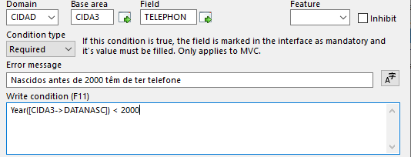
Genio Definition
The field is mandatory when the condition is true
A field that is already marked as Required cannot have a condition of this type

Slide 4
Demo

Slide 5
User defined functions
The formula responds to changes in the interface, like with ‘Show When’
Both a C# function and a javascript function will be implemented
Not implemented in Backoffice.
In Qweb the server side execution will still execute, but there is no implementation in the client side

