Slide 1
Table conditions

Slide 2
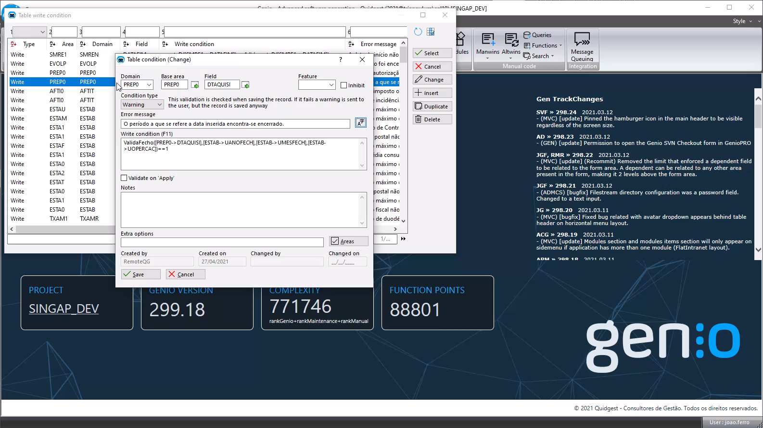
Table level conditions

Slide 3
Table level conditions
Write conditions moved from the field to be below the table.
Multiple write conditions for each field
Features for write conditions
Ability to grow the model and converge other patterns to a cleaner interface
Quickly search and check conditions

Slide 4
3 entry points
Form field
  Table list with all conditions in a field
From table definition
  List with all conditions in the same domain
From top level
  List with all Genio conditions

Slide 5
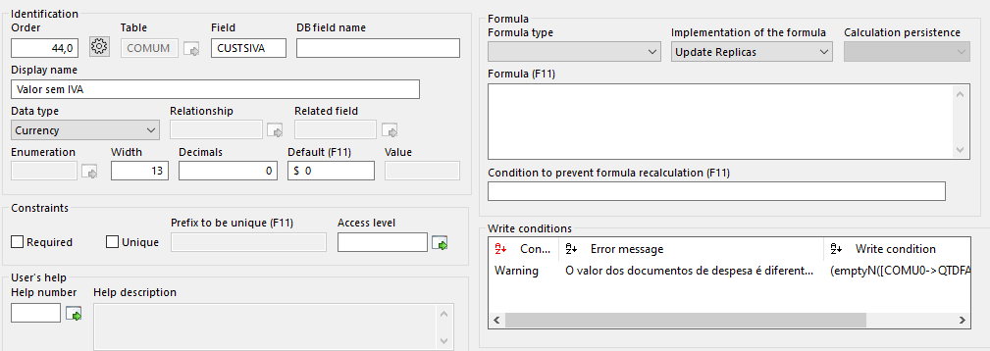
Field

Slide 6
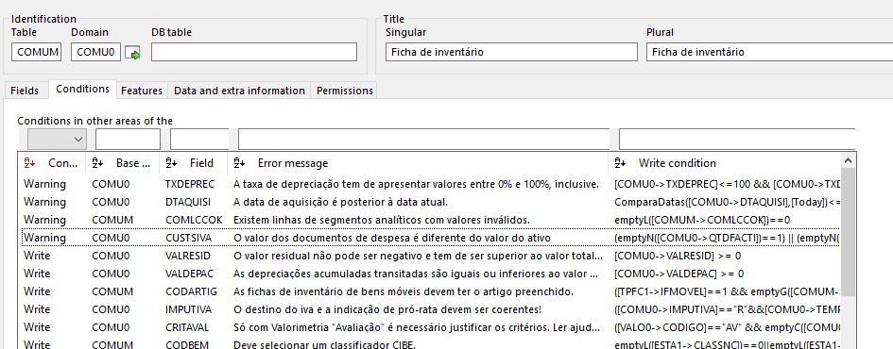
Table
The conditions from all areas of the domain are shown

Slide 7
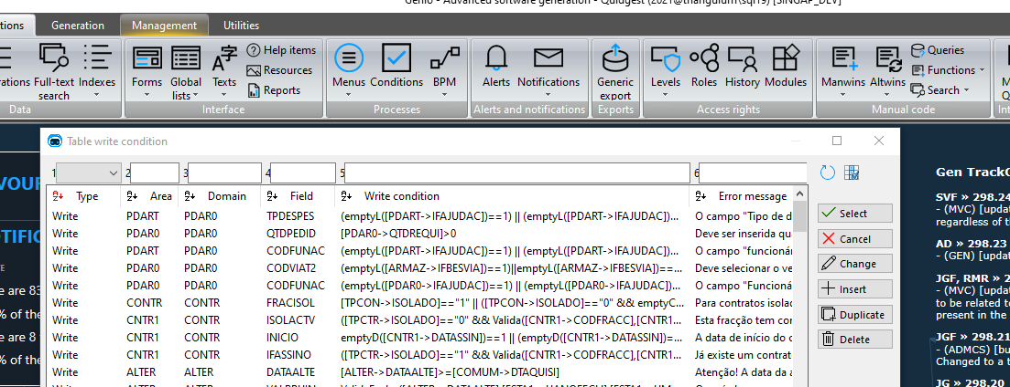
Top menu

Slide 8
Area independent expressions
Write conditions moved from the field to be below the table.
Multiple write conditions for each field
Features for write conditions
Ability to grow the model and converge other patterns to a cleaner interface

Slide 9
Area independent expressions
Expressions are only implemented in one area now, and Genio will infer the formulas for other areas.
Genio will follow the necessary foreign keys to ensure which areas can be generated
There is a button to check all the dependencies to the field

Slide 10
Area independent expressions
Domains: PERSO (Person) and HOSPI (Hospital)
HOSP1
HOSP2
HOSP3
PERSM
(Medic)
PERSN
(Nurse)
PERSE
(Employee)
PERSO (Person) and HOSPI (Hospital)

Slide 11
Area independent expressions
Formula 1:
In table PERSM
[PERSM->AGE] > 18
Because every area of PERSO can access the AGE field, all areas will have this write condition implemented
PERSM – OK
PERSN - OK
PERSE – OK
PERSO – OK

Slide 12
Area independent expressions
Formula 2:
In table HOSP1
[PERSM->COUNTRY] == [HOSP1->COUNTRY]
Because only PERSM establishes the relation to any area of HOSPI, the condition will only be generated for PERSM
PERSM – OK
PERSN – OK: The relation in CODHOSPT exists in this area
PERSE – FAIL: No link to hospital
PERSO – FAIL: No link to hospital

Slide 13
Consequences
Much less maintenance, only need to change one record instead of many
Easier duplication of areas, without having to worry about write condition consistency
Conditions are applied everywhere that it’s possible. No exception mechanism.

Slide 14
In numbers:
SINGAP_DEV Database:
Before:
1468 write conditions across all fields
Now:
518 Unique conditions. Reduction to 37%!
This 518 conditions generate 3041 different formulas

Slide 15
Other considerations
Backoffice generation was adapted
Warning messages are now mandatory!
  If there is no field associated and there are multiple conditions the default messages will confuse the user.

Slide 16
Migration
The migration routine will pass all fields in conditions to table conditions
Conditions from different areas of the same domain will be migrated to one of the areas as long as they have the same condition and message
Conditions with different messages or formulas will still be migrated but an error will be written to writeConditionErrors.txt file

Slide 17
Next steps
CRUD permission expressions
CRUD formulas from form fields
Write conditions in forms

