Slide 1
Popover options

Slide 2
Motivation
Make the presence of helps immediately noticeable
Prevent accidental triggers of potentially big tooltips

Slide 3
Using tooltips
Tooltip shows up on mouse hover
Tooltip disappears on mouse leave

Slide 4
Using popovers
Popover shows up by clicking on the information button
Popover disappears by clicking anywhere on the page (except on the information button)

Slide 5
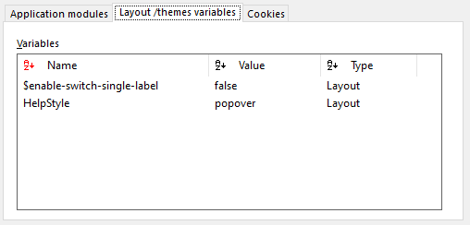
Definition
Configurable as a layout variable
Options: { tooltip, popover }
Defaults to tooltip (its previous behavior) if unset
Available since Genio 298.61

Slide 6
Next steps
Open to discussion:
Use tooltips for succinct helps, popovers for verbose helps
Support help by URL
Support text formatting (HTML, Markdown)
Requires additional knowledge
Markdown would require an additional layer of abstraction
Example taken form third-party app

