Slide 1
Single point of entry to display messages
Tiago Pereira

Slide 2
Objectives
Reduce the dependency on the framework chosen to display messages for the user (currently it’s bootbox);
Standardize the manner in which we request a message to be displayed

Slide 3
Definition
This functionality is already in use since version 298.44.
Since that version, most of the messages which are displayed from generate code are using this function. There are some patterns of which we did not have examples and thus, were not changed.

Slide 4
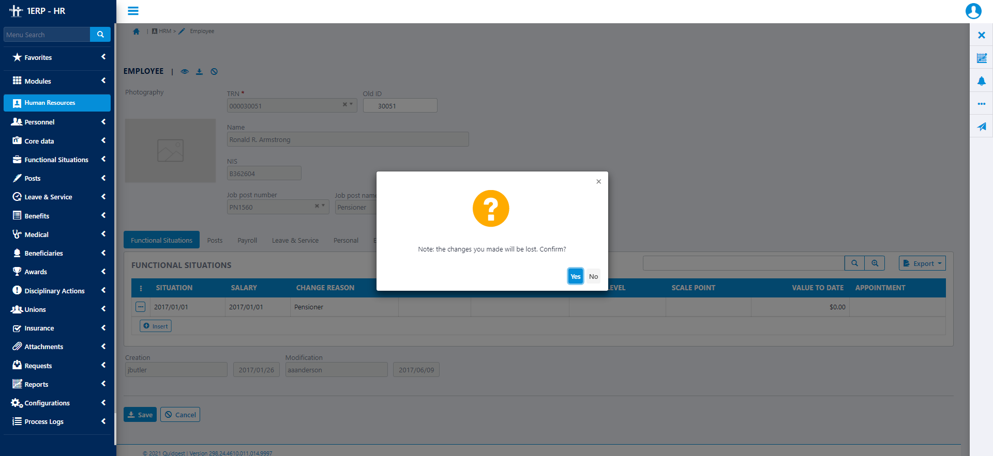
Definition

Slide 5
Definition
The modals automatically close when the user clicks outside the modal (background).
DisplayMessage(message, status, title, buttons, options);
Message – The only mandatory parameter;
Status – Determines the icon which is displayed and its colour;
Title;

Slide 6
Definition
DisplayMessage(message, status, title, buttons, options);
Buttons – array of objects with the structure:
Label – the only mandatory parameter;
Callback – function called when the button is clicked (optional);
Style – colour of the button (defaults to Primary style);
When it is not filled, its value will be one button with an “OK” label;

Slide 7
Definition
DisplayMessage(message, status, title, buttons, options);
Options – allows for extensibility without having to change the function’ signature. Currently the function recognizes these options:
OnEscapeCallback – Binds a function to be called when the modal is closed. Can either be a button index or a function;
Timeout – automatically closes the modal. This does not trigger the OnEscapeCallback;
Inputs – Array of objects which recognizes the type and name members. Currently only supports the text type.

Slide 8
Customization
In order to help fill the status and styles variables with the correct values, there is an object called MessageDefs which short-hands the various strings which are supported out-of-the-box.
However, the function itself is not limited by it so it is possible to add new/change the statuses/styles without having to change the function.
The svg which are used as icons are changeable as they are in the Content/img folder with the naming rule Dialog_[Status].

