Slide 1
Password control
PSW registration form
MVC

Slide 2
Controlled Records
New attributes for password control
Allow the password form to be more customizable.

Slide 3
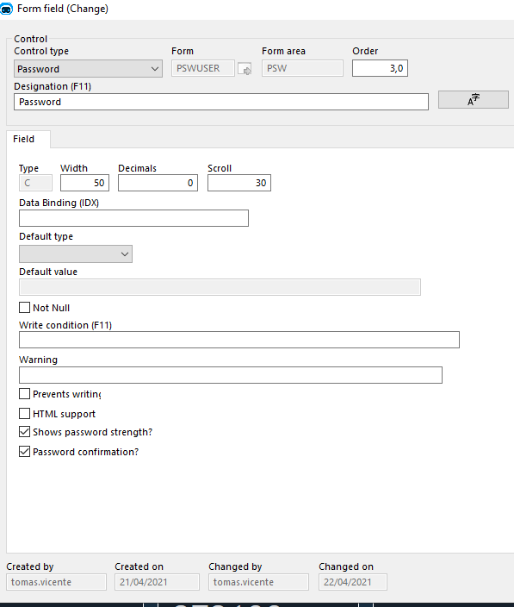
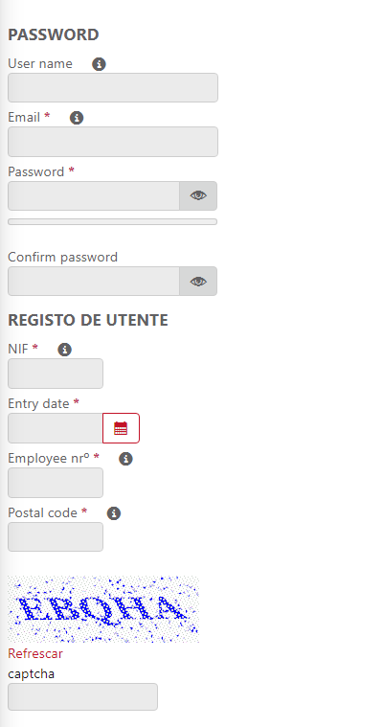
New atributes to the passwrd control

Slide 4
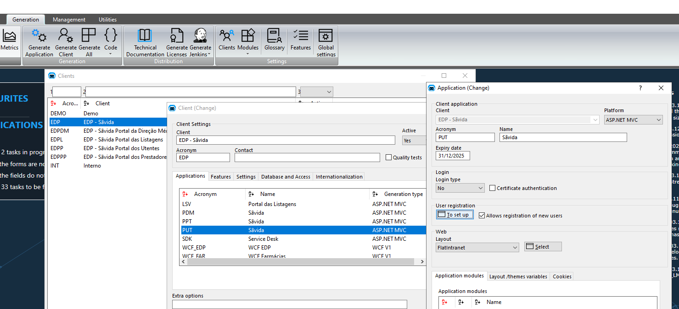
Custom password form in user registration

Slide 5
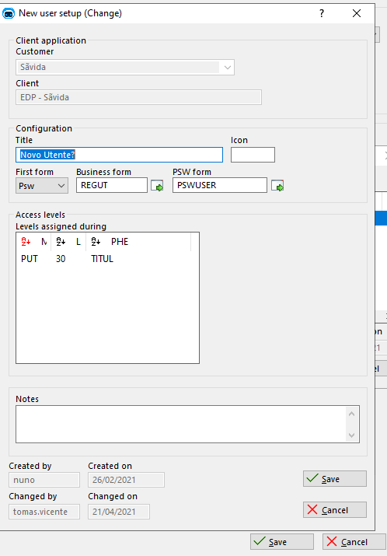
Costom password form in user registration

Slide 6
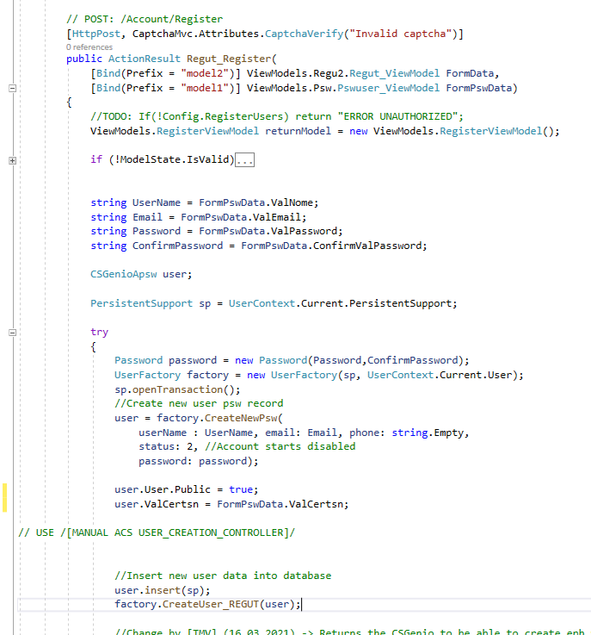
New manwin entry in user registration

Slide 7
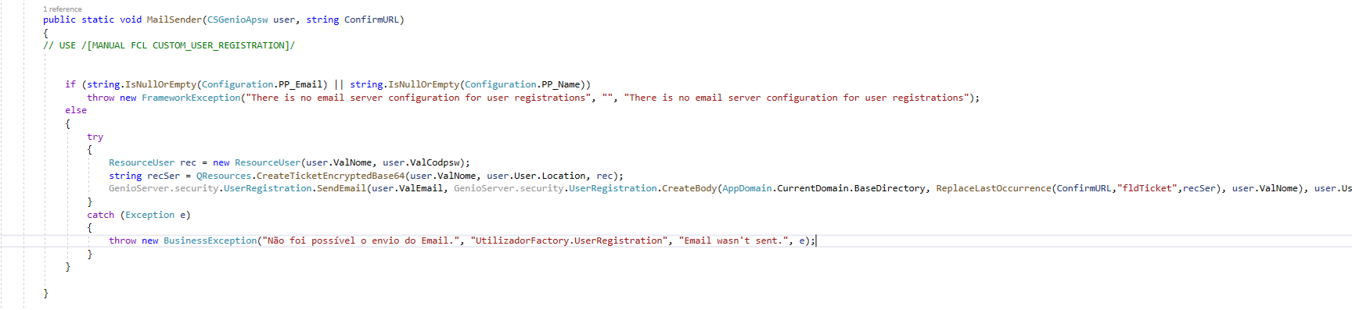
New manwin entry in user registration

Slide 8
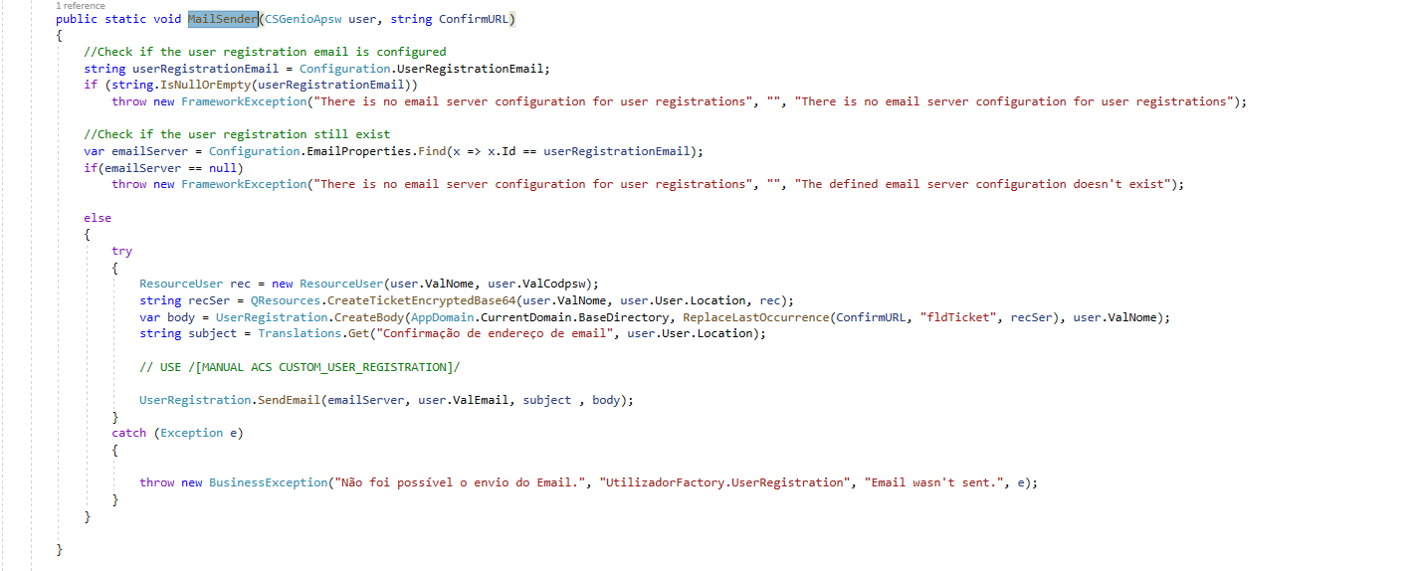
New manwin entry in user registration

