Slide 1
Cascade delete changes

Slide 2
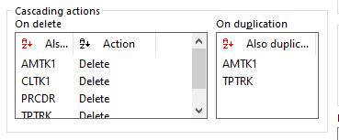
Cascade delete
Country
Ruler
Region
Languages
Province
We could add an On delete to country to force the elimination of regions, rulers and languages when the Country is deleted

Slide 3
3 changes
Delete if new
Check all dependencies before proceeding
Better support for tree deletion

Slide 4
Delete if new
If you were inserting or duplicating a country, and then canceled, the framework would not allow it, because Region was not a new record and would not force the deletion of province.
From now on, the evaluation is always made on the root record
Country
Zz = 1
Delete if new
Region
Zz = 0
Delete if new
Province
Zz = 0

Slide 5
Check all dependencies
Previous behaviour
Delete country
Error saying that rulers must be deleted
Delete rulers
Delete country
Error saying region must be deleted
Delete region
Error saying province must be deleted
Etc
Country
Ruler
Region
Languages
Province
No delete cascades anywere

Slide 6
Check all dependencies
New behaviour
Delete country
One error saying there are dependencies in Ruler, Region, Province and Languages tables
Delete all identified dependencies
Great success
Country
Ruler
Region
Languages
Province

Slide 7
Tree table deletion
Genio could handle the deletion of tree data, but only when you were deleting directly a tree record.
In the example, you could delete a requirement, but not a norm
From now on, it should be possible to delete all tree structures with cascade deletion
Norm
Delete
Requirement
(Tree like table)

Slide 8
Next steps
Revision of invalid zzstate script to follow cascade deletions
Revision of definition of cascade deletions to be done at a domain level, but specifying different behaviours for different keys

