Slide 1
Layout Options/Interface improvements
José Gomes

Slide 2
Layout options
“$enable-table-wrap” (new)
$menu-multi-level (new)
MenuSearchEnable (new)
BookmarkEnable (new)
HeaderPlacement (Default value changed)

Slide 3
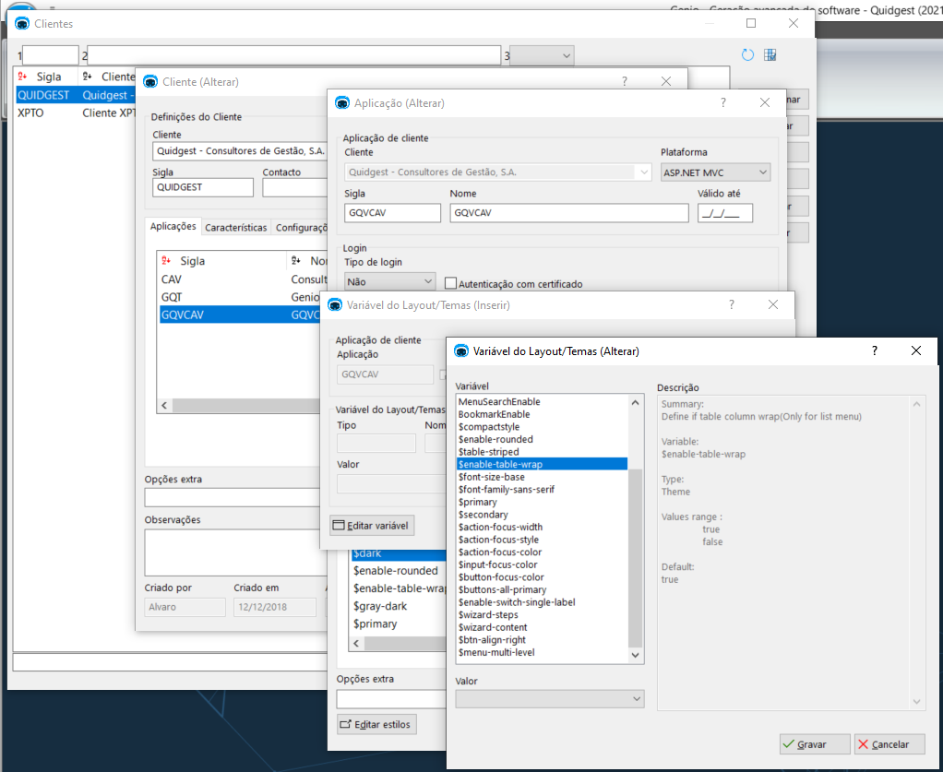
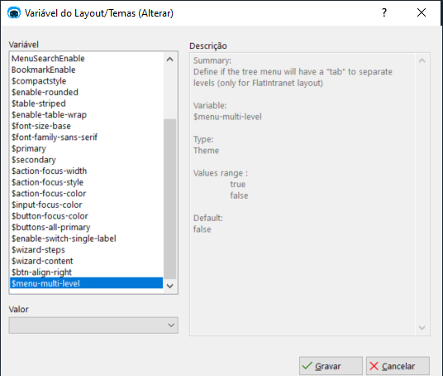
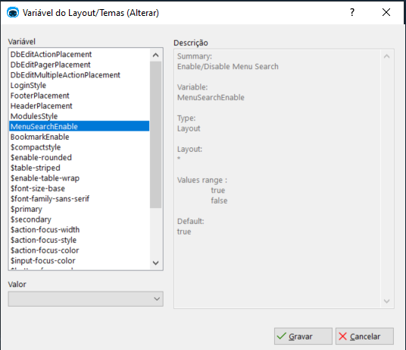
Layout options (Genio)

Slide 4
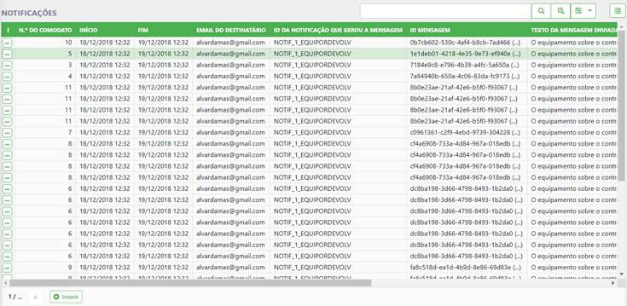
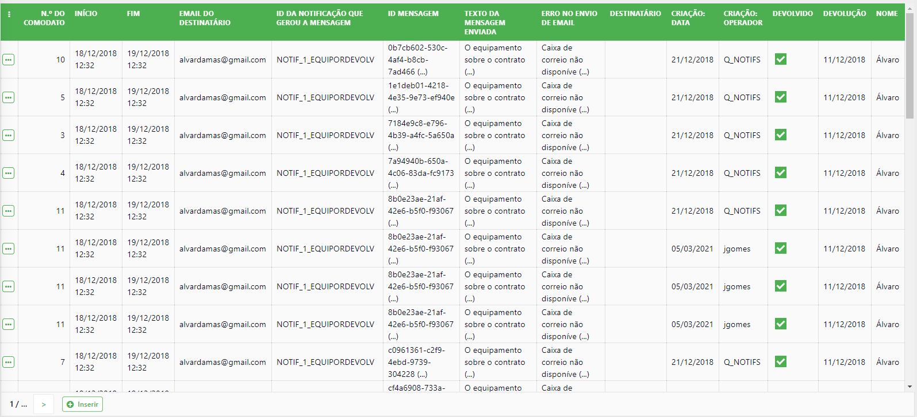
“$enable-table-wrap
$enable-table-wrap:false
$enable-table-wrap:true

Slide 5
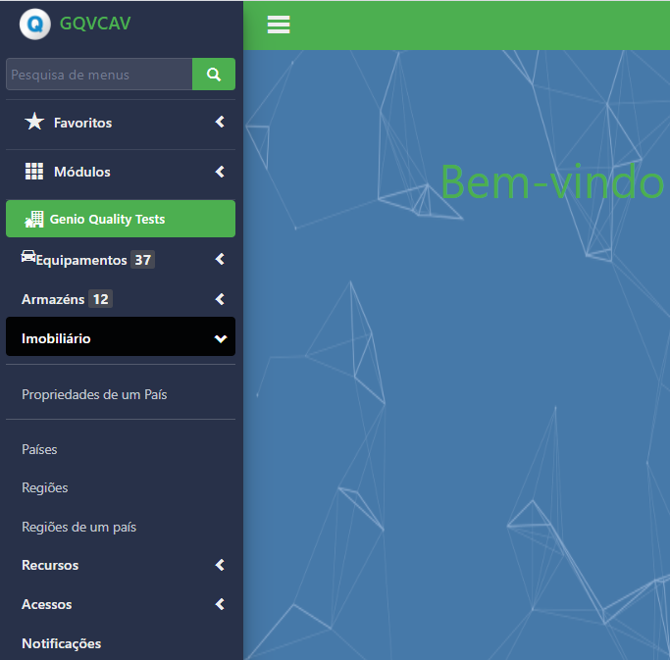
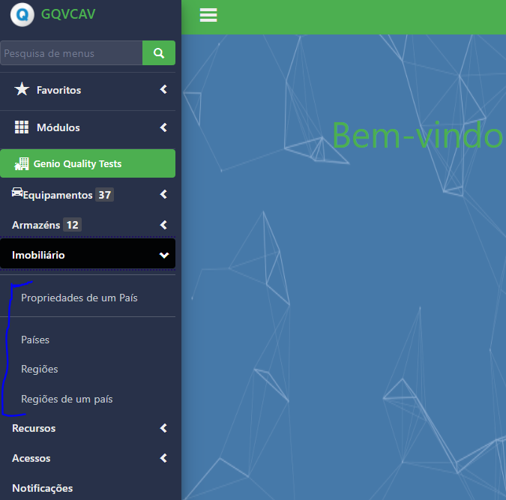
$menu-multi-level
$menu-multi-level:false
$menu-multi-level:false

Slide 6
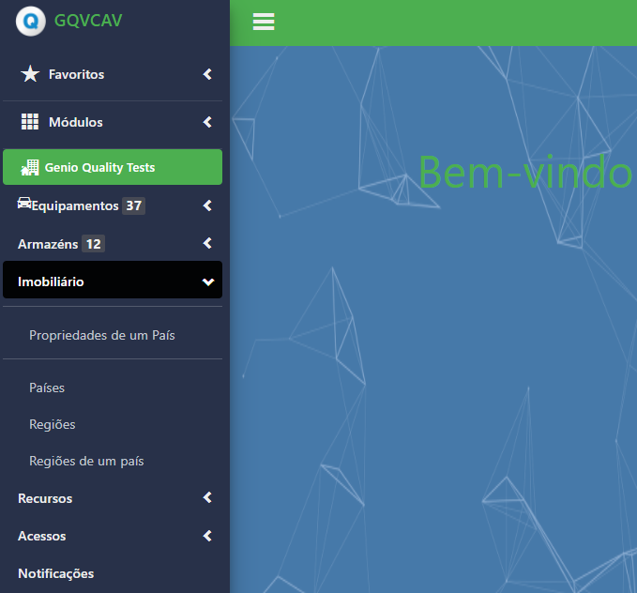
MenuSearchEnable
MenuSearchEnable:true
MenuSearchEnable:false

Slide 7
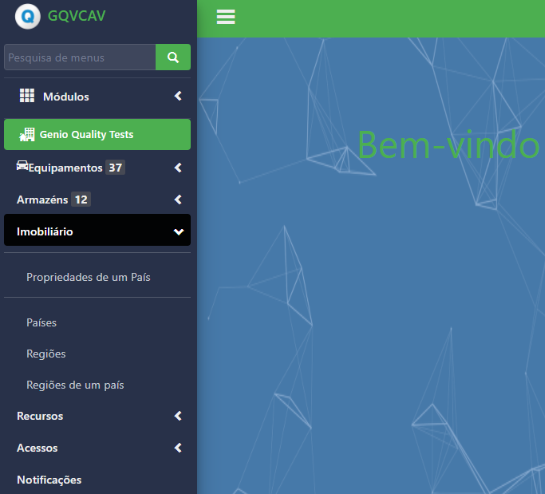
BookmarkEnable
BookmarkEnable:true
BookmarkEnable:false

Slide 8
HeaderPlacement (FlatIntranet)
Default value changed:
Before:
<HeaderPlacement>in_contentPanel</HeaderPlacement>
After:
<HeaderPlacement>in_menuPanel</HeaderPlacement

Slide 9
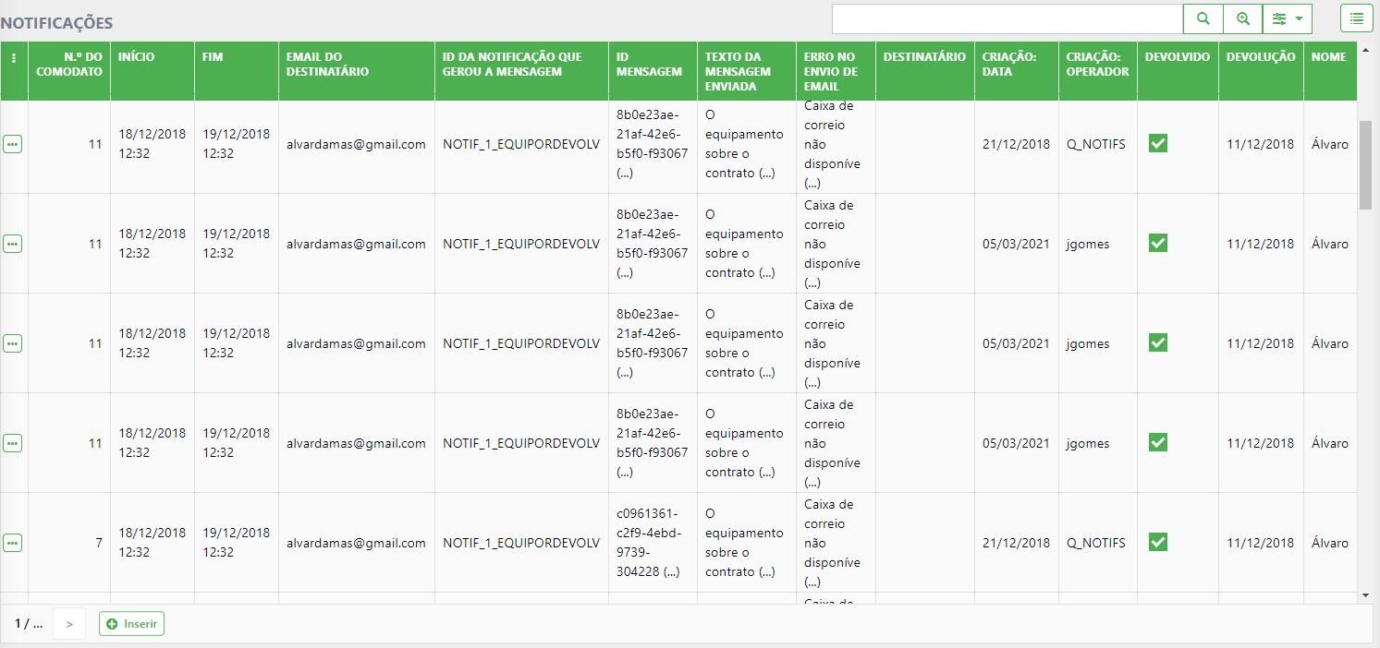
Interface Improvements
Fixed header for list tables (DbEdit) with vertical scroll

Slide 10
Thank you

